Slide 1
Human Computer Interaction
Airline App Redesigning
Aaron Raymond Buthelo
01746342

Slide 2
Application Name: Virgin Atlantic
Category: Transportation
Platform: Android
Average Reviews: 2.9 (Google Play Store)

Slide 3
Tasks
Diego, a 33-year-old entrepreneur from California owns a hardware business. He flies from San Francisco to Boston on the 1st of every month for his business meetings and is usually back within 3 days. Entertainment is a big deal for him as he does not sleep during the long flight. When on the flight he likes to watch Spanish movies and listening to Spanish songs. He would love if the airline mobile application enables him to choose the videos and audios that he wants to listen in the flight before boarding the flight.
Mary a 74-year-old diabetic patient travels from Chicago to London every 3 months for regular medical check-up. Last time when she travelled from Chicago to London, she became hypoglycemic. This time around she is worried it might happen again. She wants the airline to enable on demand food assistance or emergency assistance (providing a glucometer to monitor her blood glucose level) via a mobile application in a quick time.

Slide 4
Tasks
Shanti is a teenager who stays with her grandparents in the United States. She visits her parents in India every summer vacations alone. Last summer she missed her flight from Seattle to Mumbai, as her flight’s departure was changed from gate 12 to gate 10. Since, she did not receive any notification of the gate change and as she was already running late, she couldn’t board the plane. This summer she is planning to go to India again. As time management isn’t one of her key strengths, she is looking for an airline which can assist her with managing time to successfully board the plane in time.

Slide 5
Prototype Screenshots

Slide 6
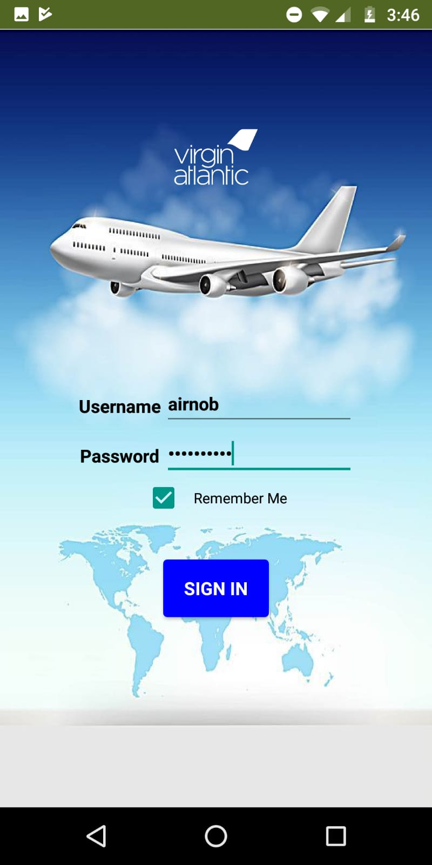
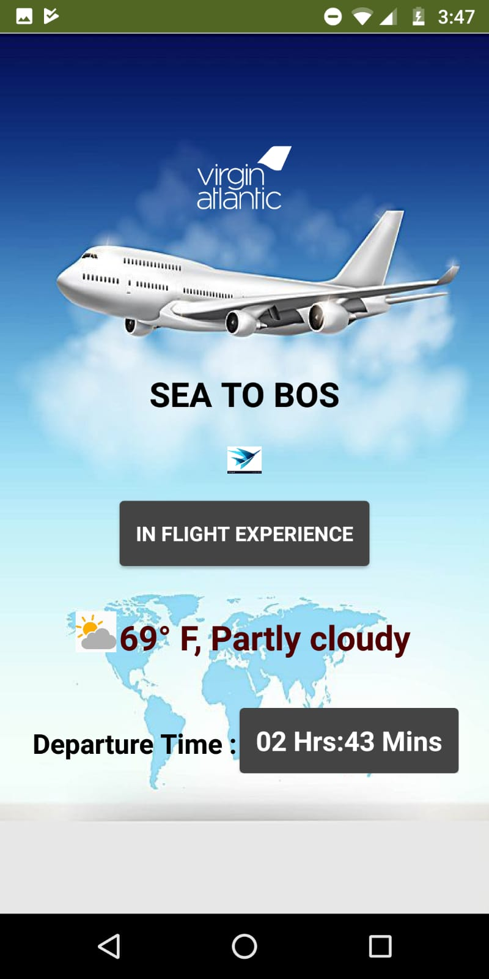
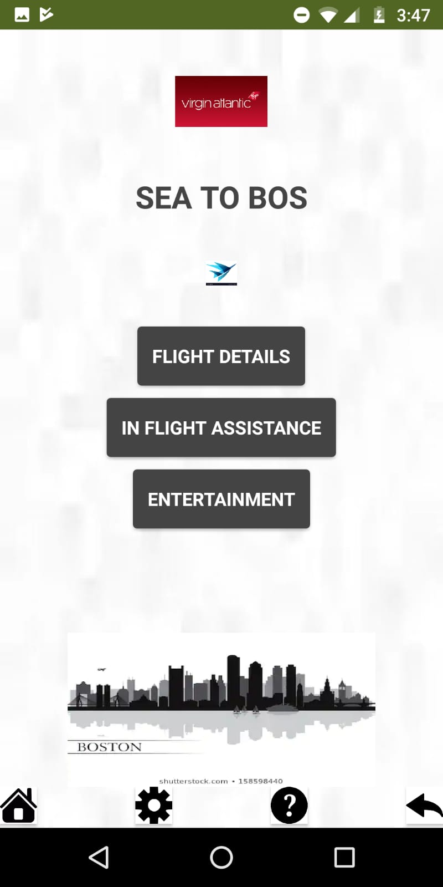
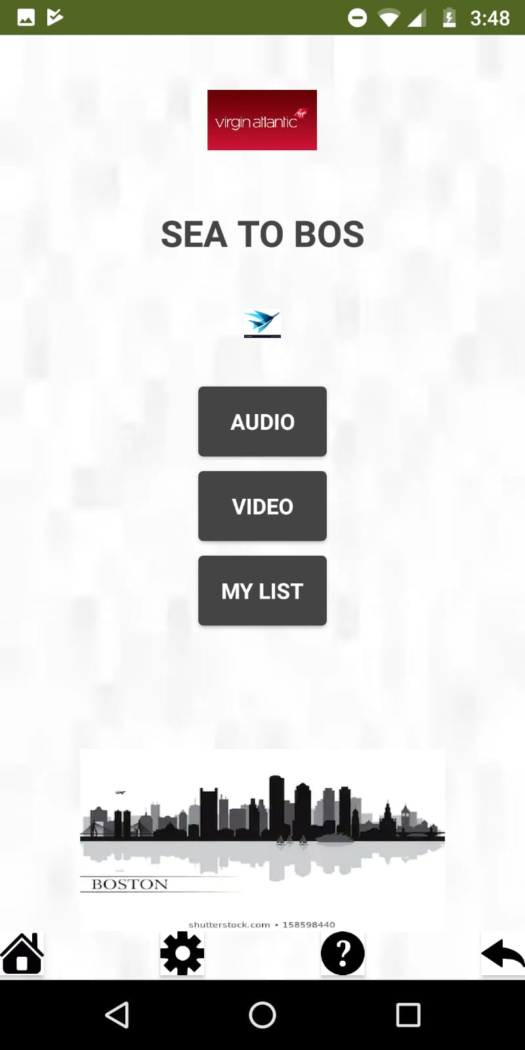
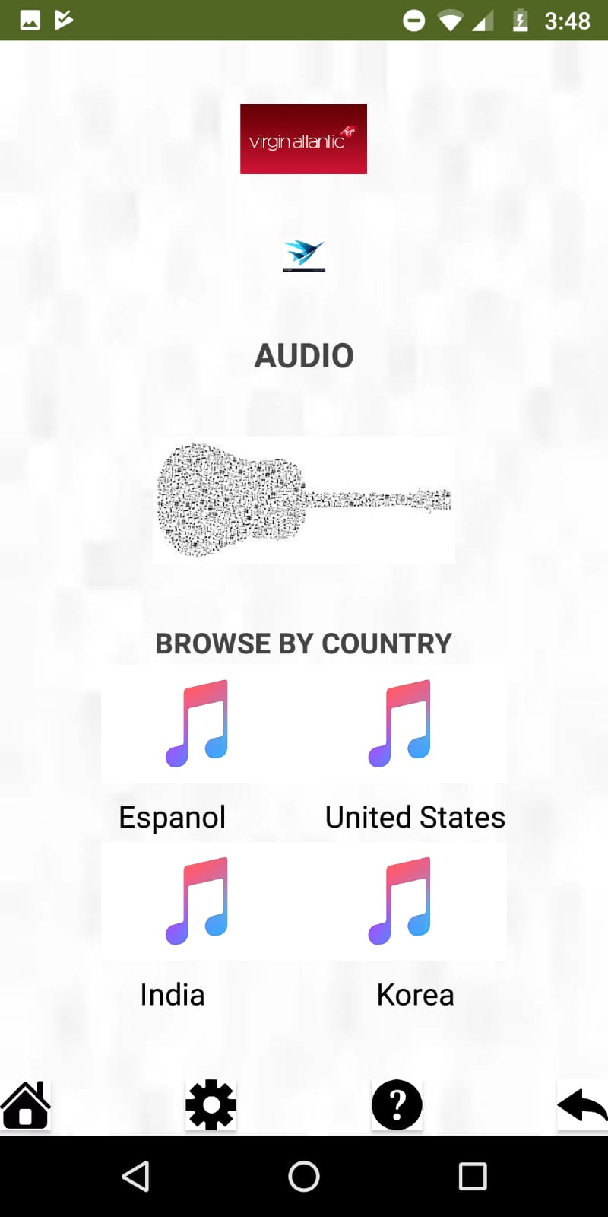
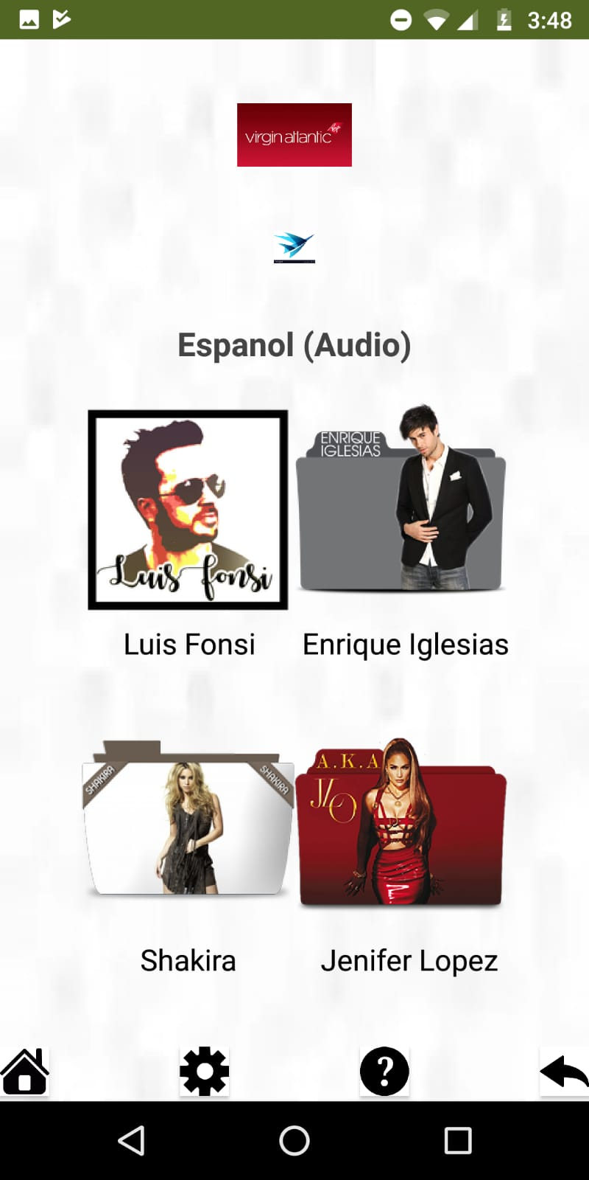
Task 1
Here the objective was to allow Diego select Spanish songs that he can listen to when on board.

Slide 7
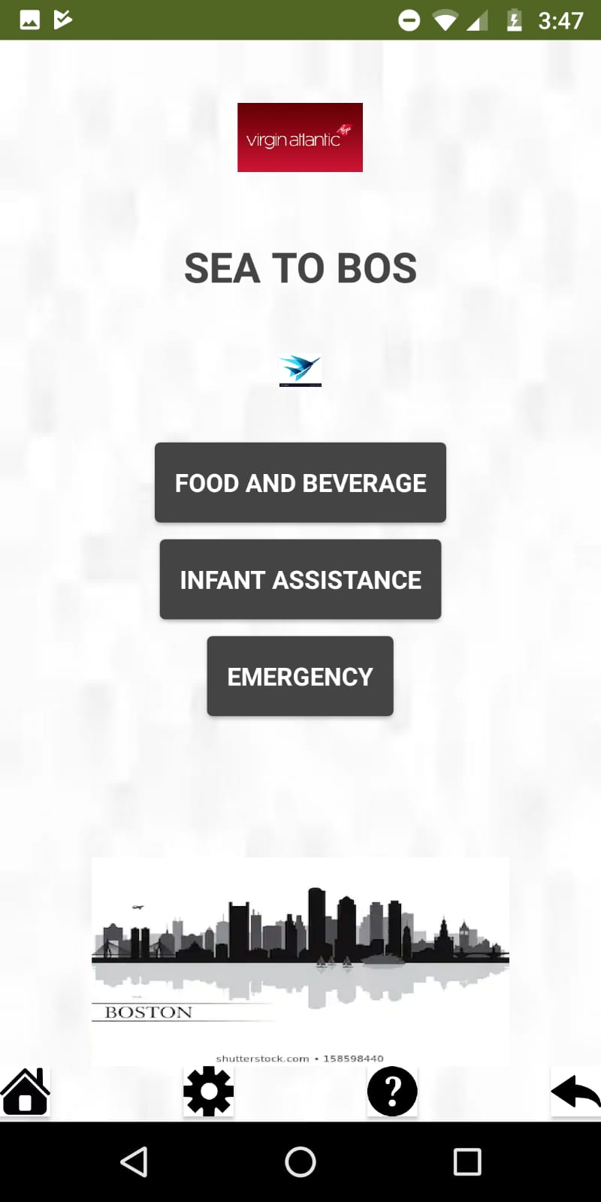
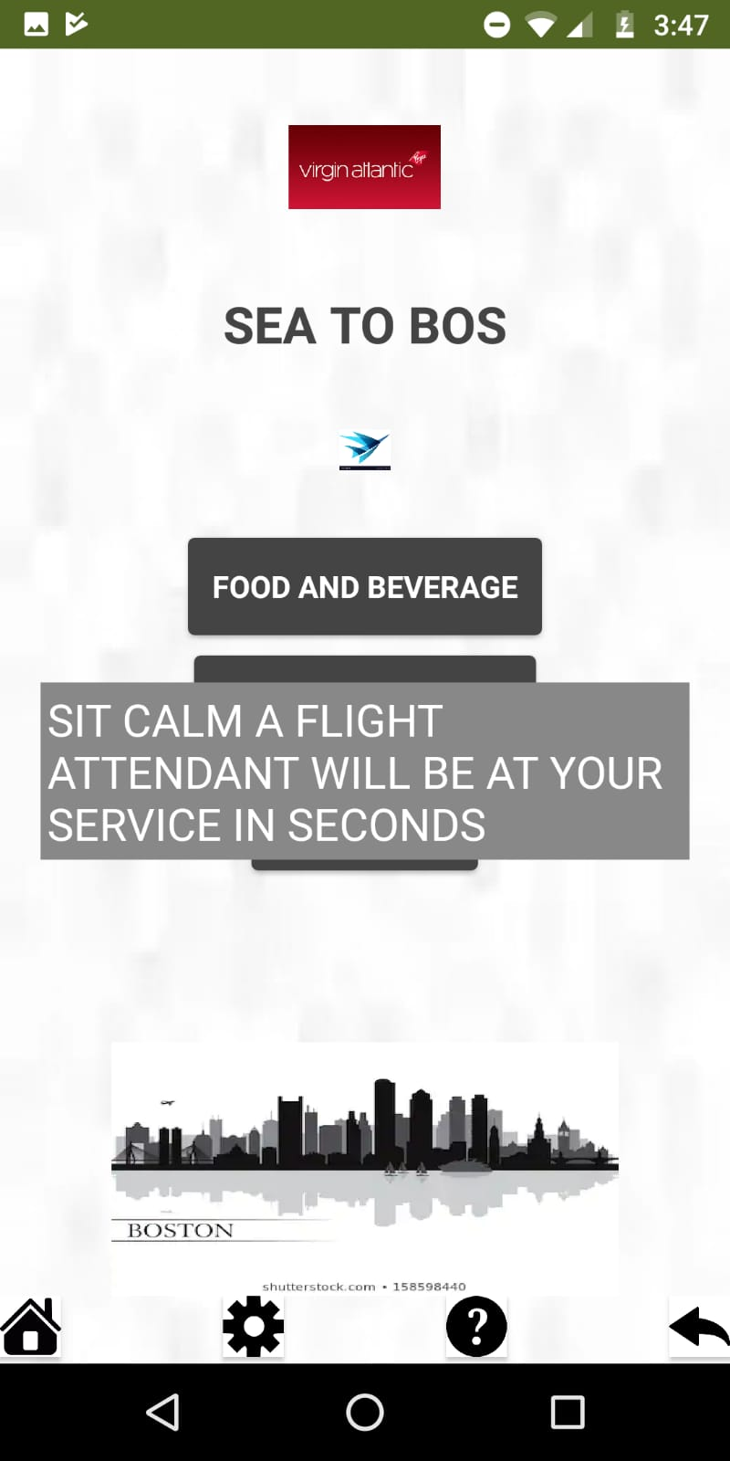
Task 2
Here the objective was to let Mary have quick access to a flight attendant in case of emergency.

Slide 8
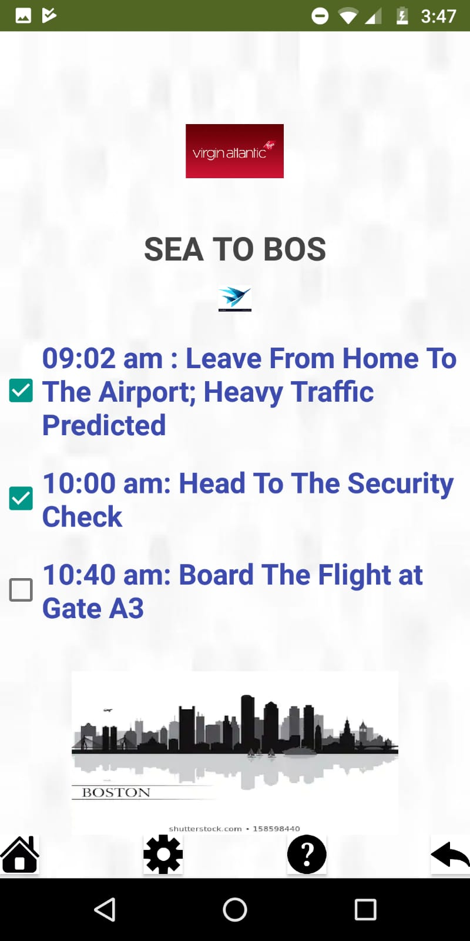
Task 3
Here the objective was to assist Shanti in managing time so she can successfully board the plane in time.

Slide 9
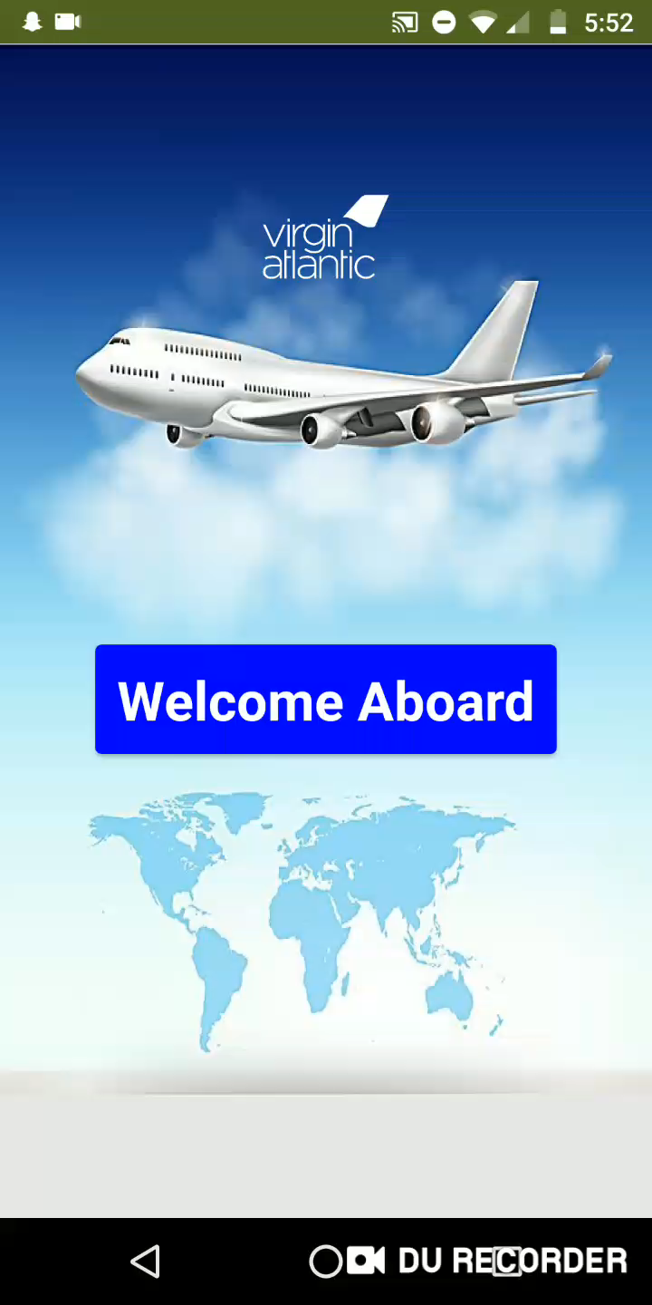

Slide 10
Reference
MIT app inventor 2
YouTube

